Slide 1
SDF
Sign Distance Fields, etc...

Slide 2
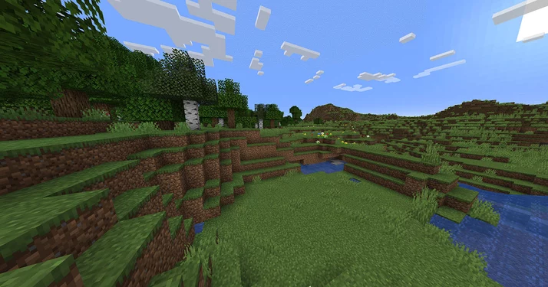
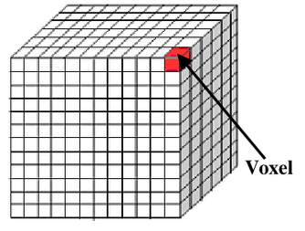
Voxels
(Minecraft)

Slide 3
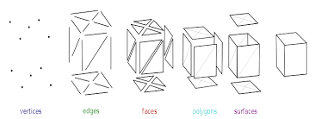
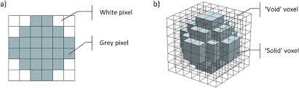
Meshes
Mesh
vertices = [[float, float, float], [float, float, float], ...]
faces = [[int, int, int], [int, int, int], ...]
colors = [[int, int, int], [int, int, int], ...]
Each vertex is a point x,y,z in 3D.
Each face is a set of indices into the vertex array.
Each color is a set of RGB values that correspond to a face.

Slide 4
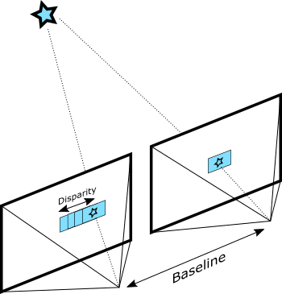
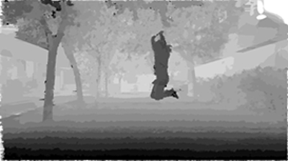
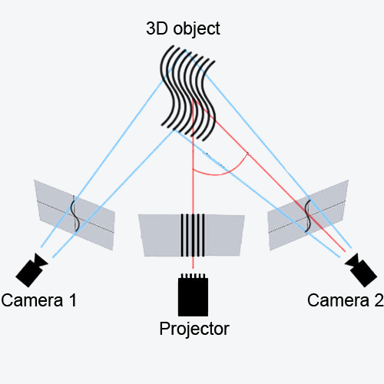
Sensors: Active and passive cameras

Slide 5
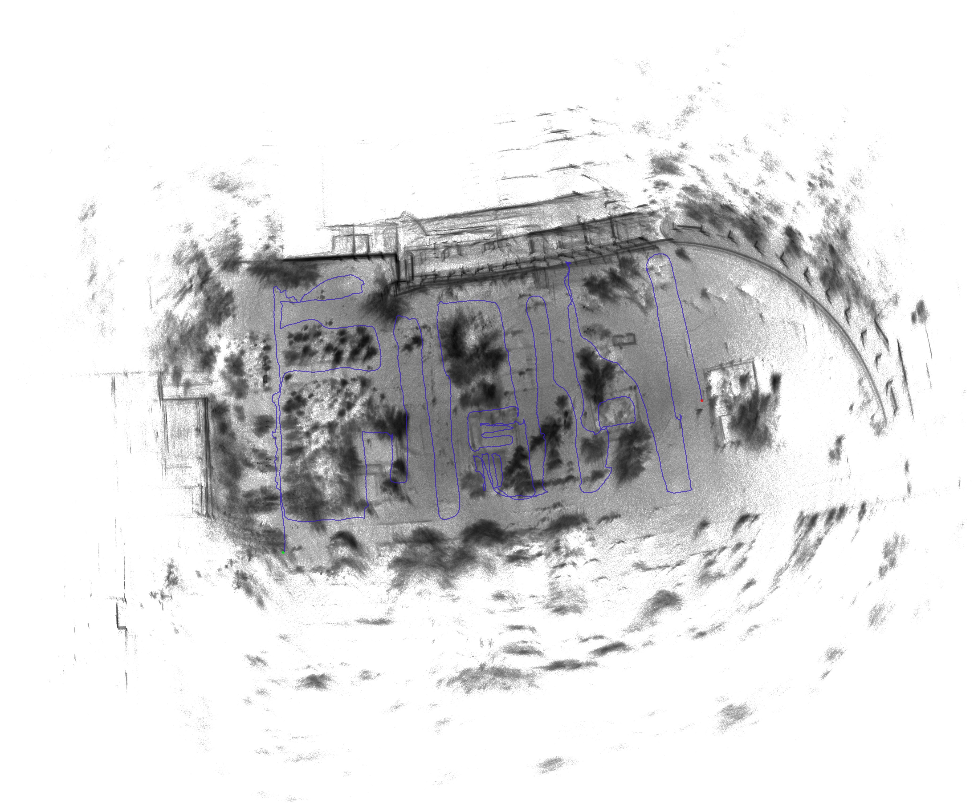
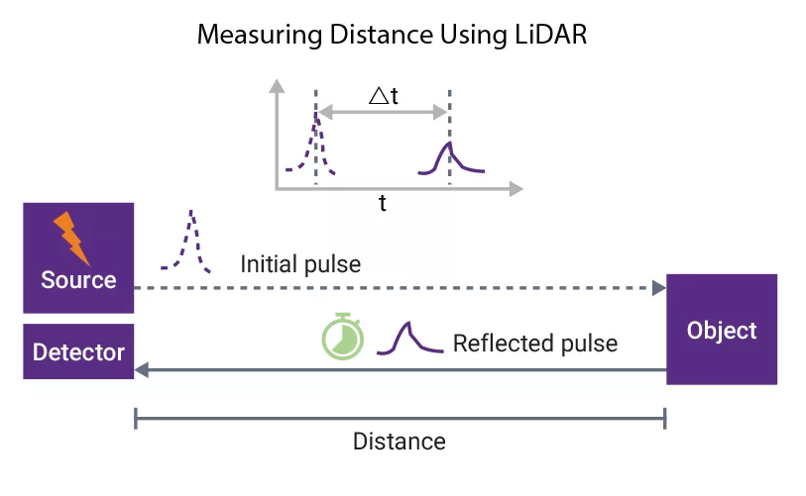
Sensors: LiDAR

Slide 6
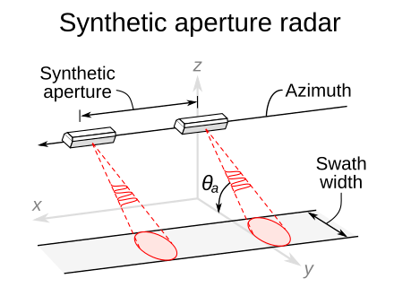
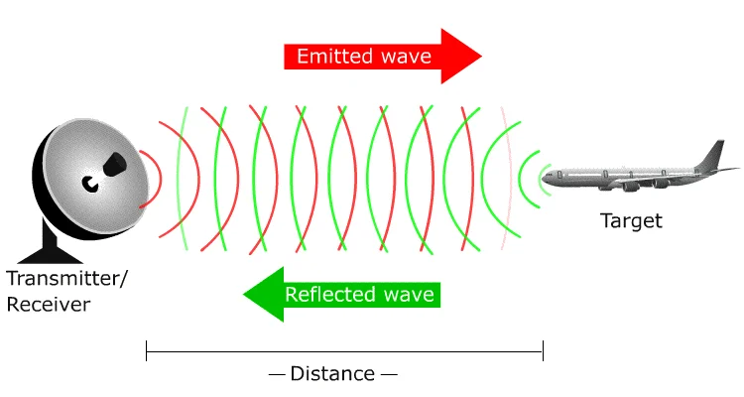
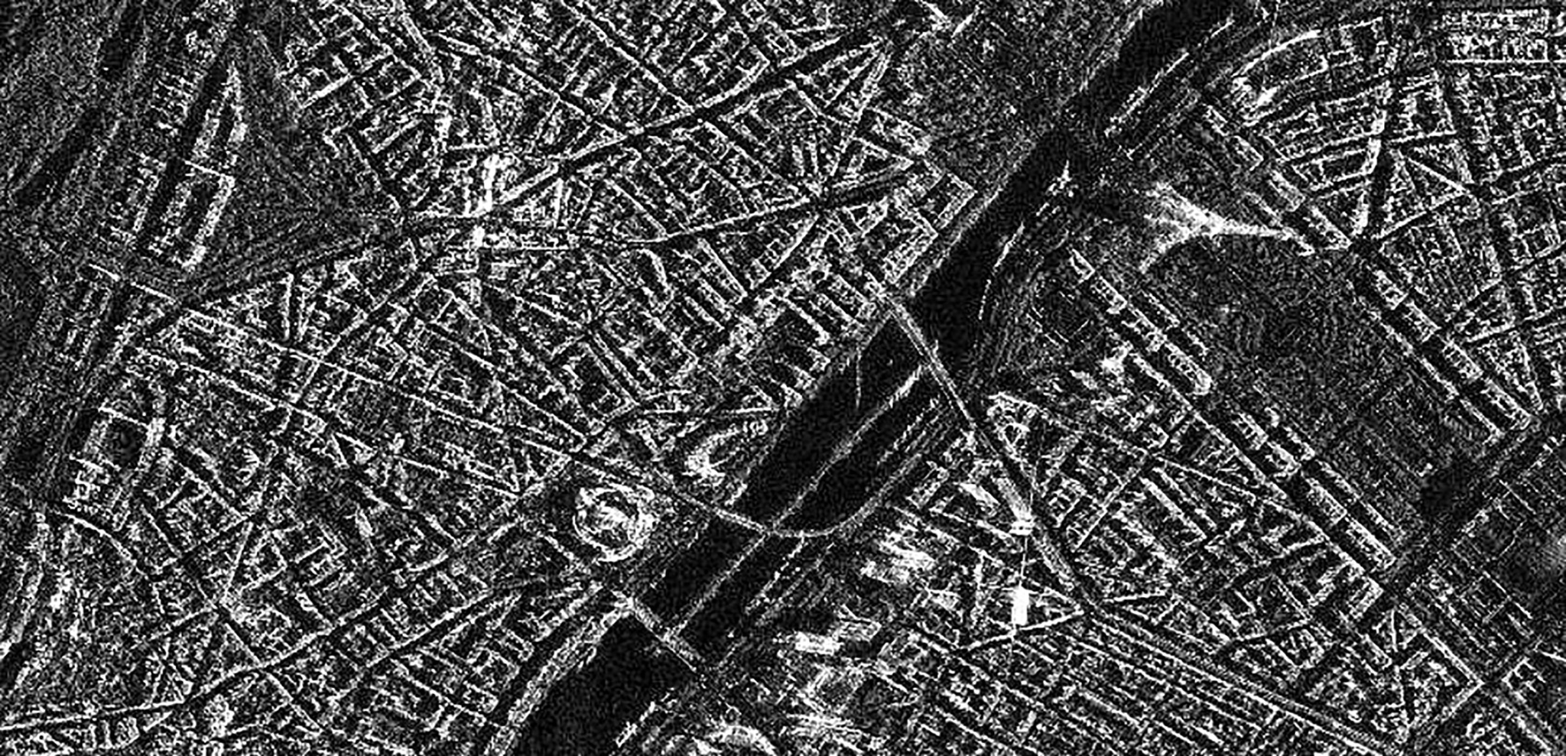
Sensors: Radar
(Motion imitates aperture)

Slide 7

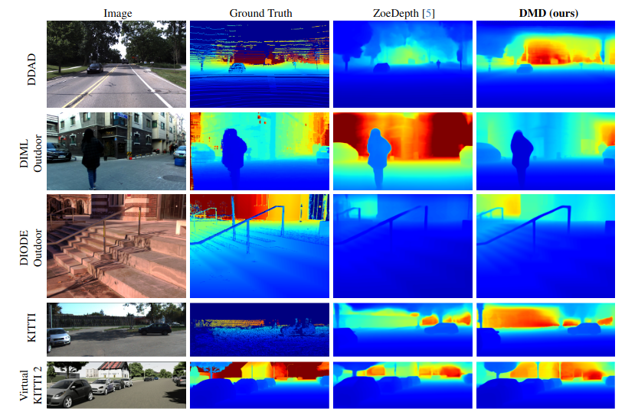
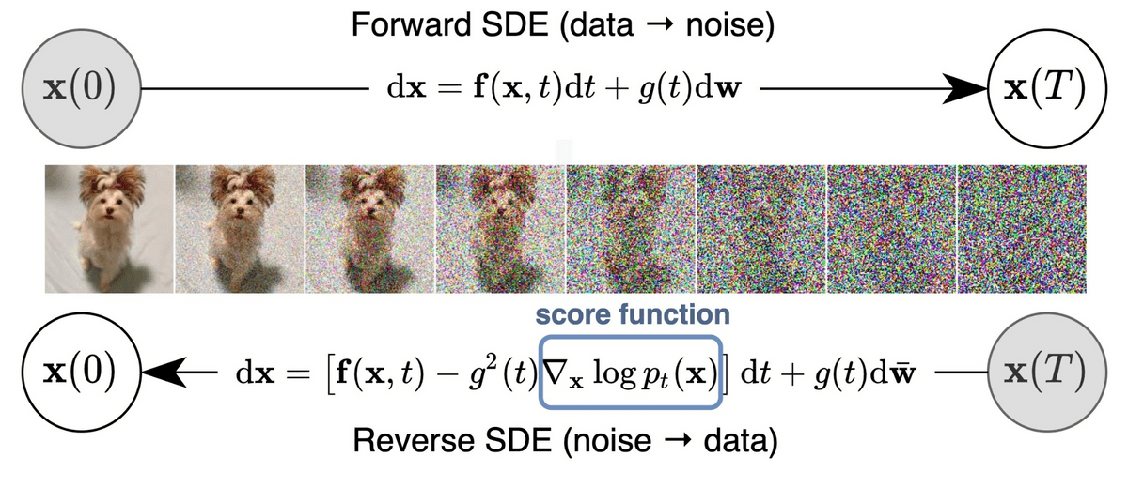
Sensor? Metric Depth Diffusion
https://diffusion-vision.github.io/dmd/

Slide 8
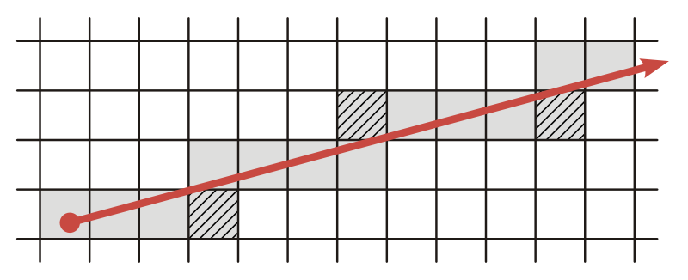
Ray tracing

Slide 9
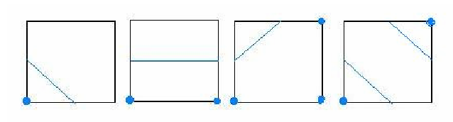
Marching cubes
- iterate over all voxels
- draw lines isolating vertices
- voxels with 1, 2, or 3 vertices require drawing
- voxels with 0 or 4 are inside the isosurface

Slide 10
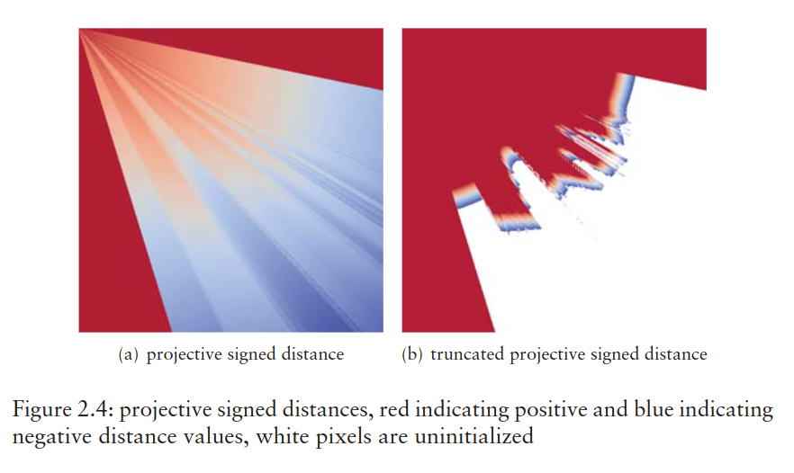
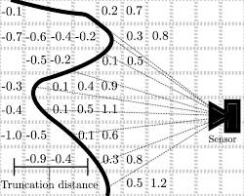
Truncated signed distance field
(zero level black line)
(TSDF applied to robotics)

Slide 11

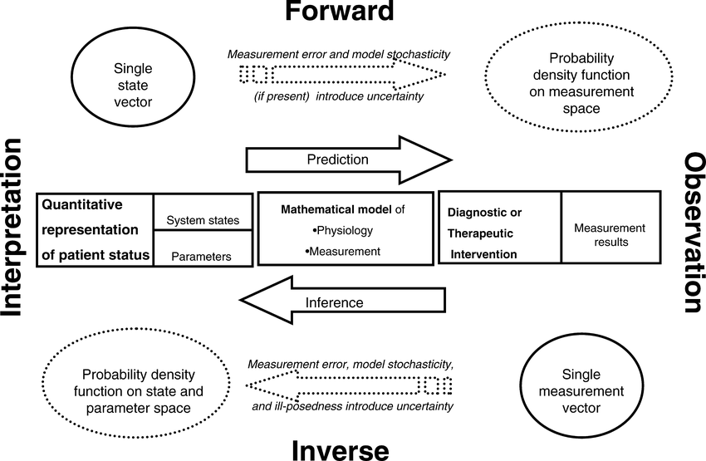
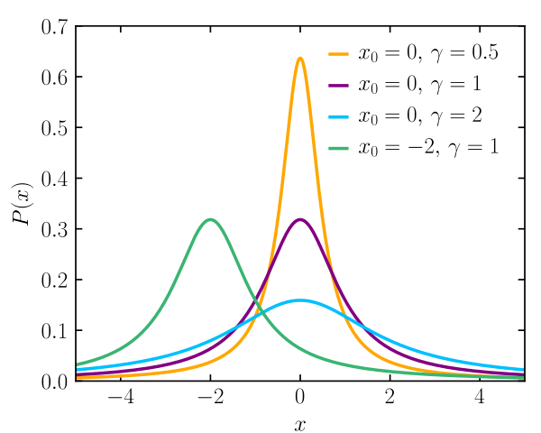
Reconstruction: Forward, inverse, Bayesian

Slide 12
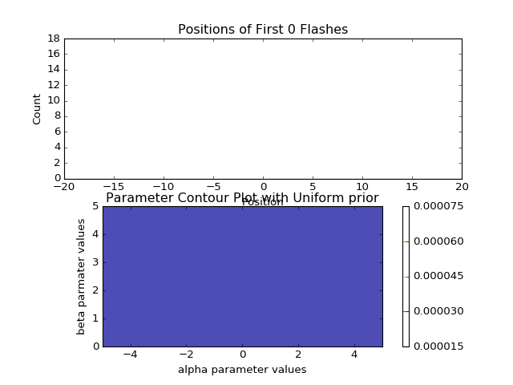
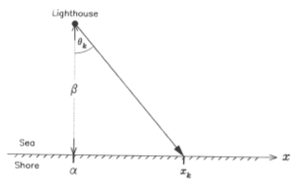
Example: lighthouse problem

Slide 13
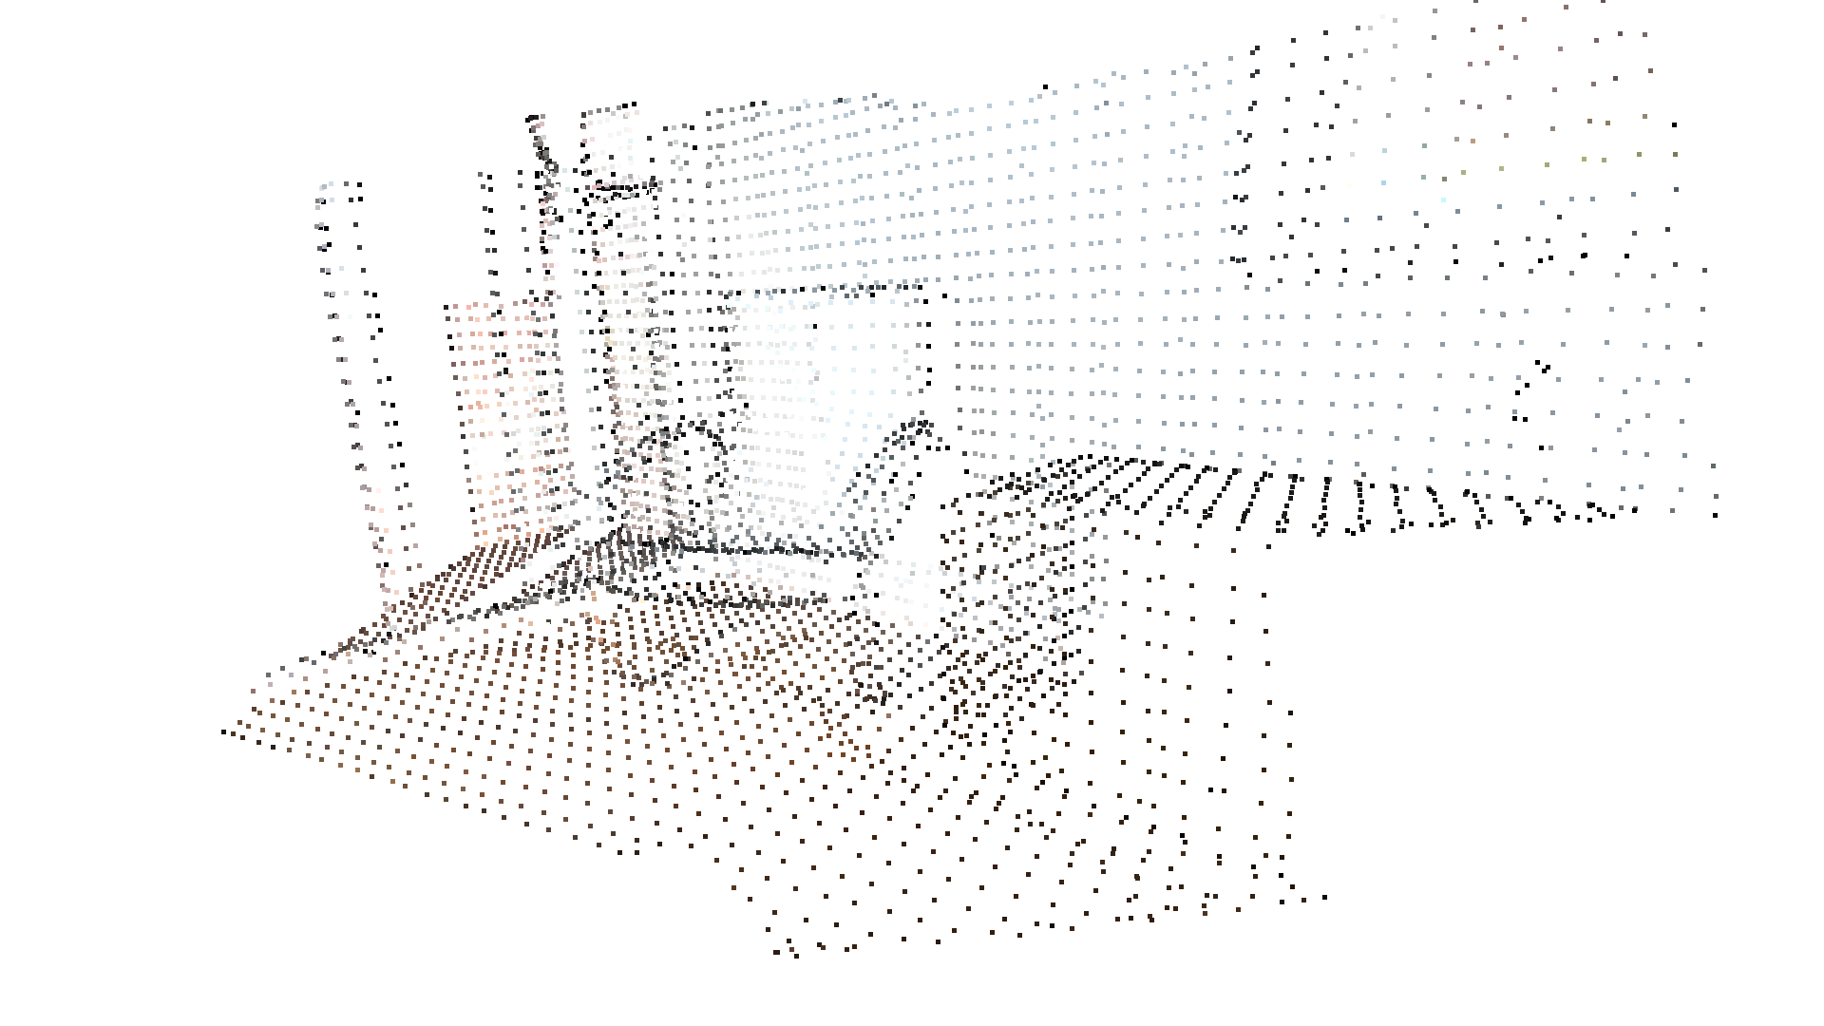
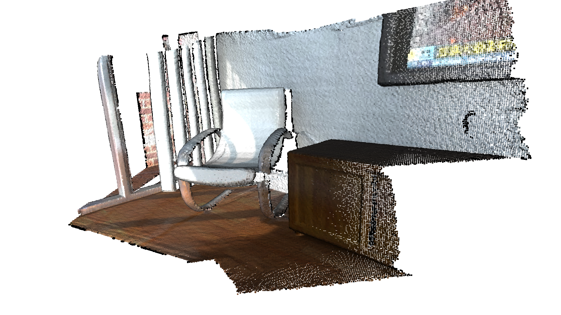
Iterative Closest Point
A mesh consists of vertices, indices, and colors array:

Slide 14
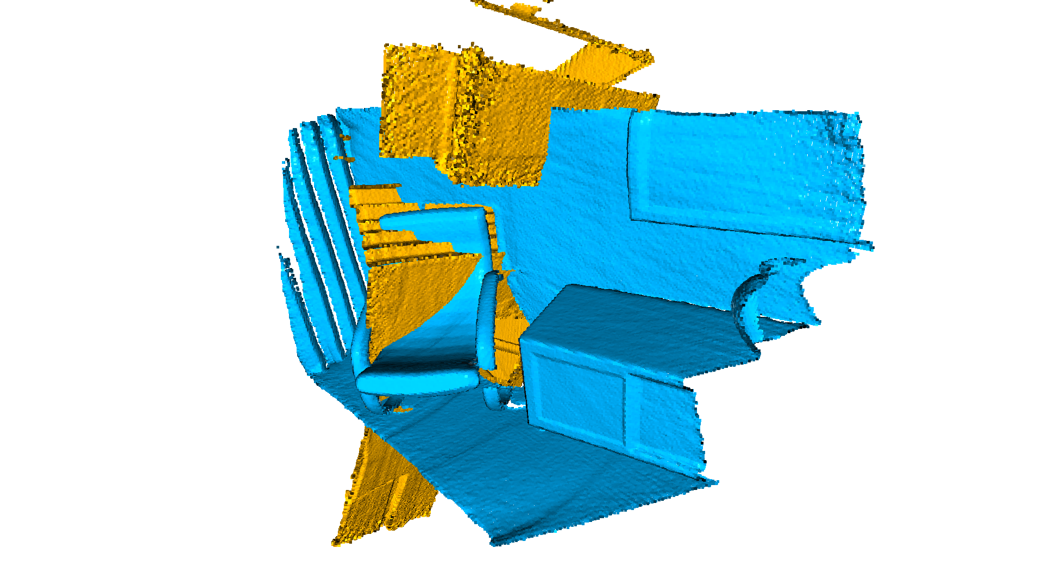
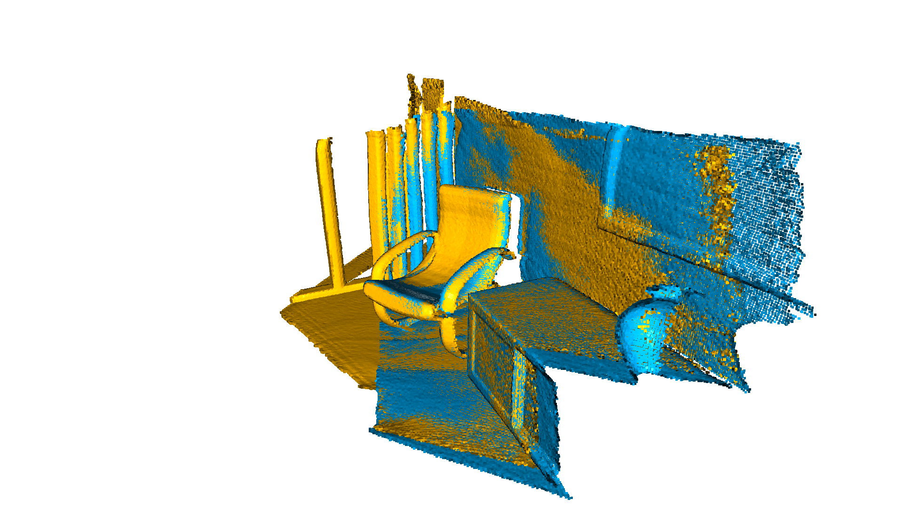
ICP: Registration
Global registration aligns geometric center
Local registration with matric factorization

Slide 15
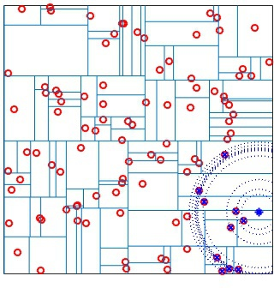
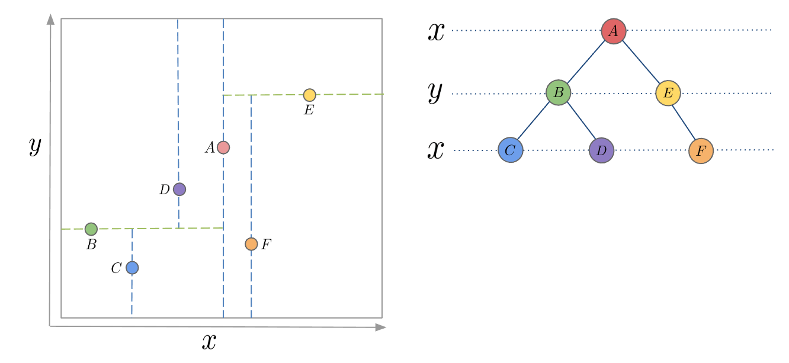
KDTree
Spatial indexing
Non-leaf nodes divides the space into partitions

Slide 16
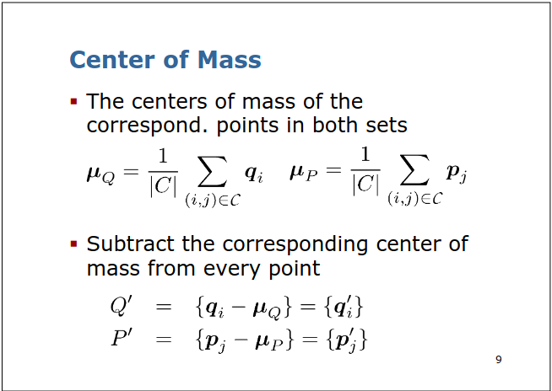
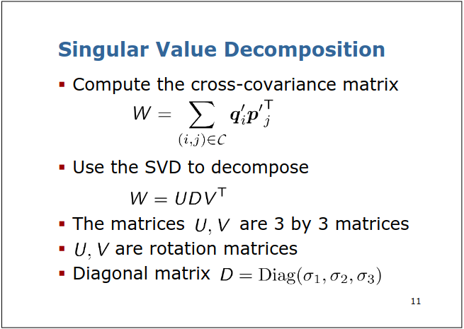
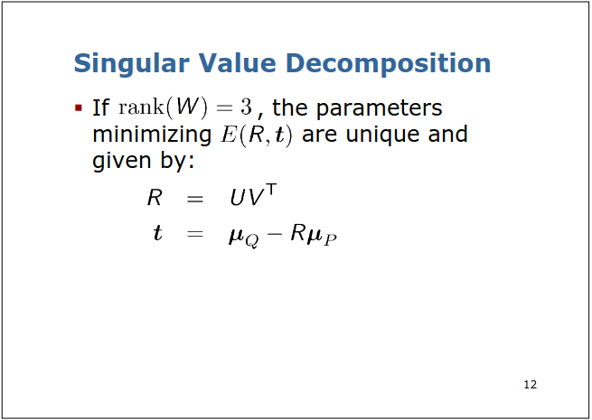
Singular Value Decomposition
(Matrix factorization)

Slide 17
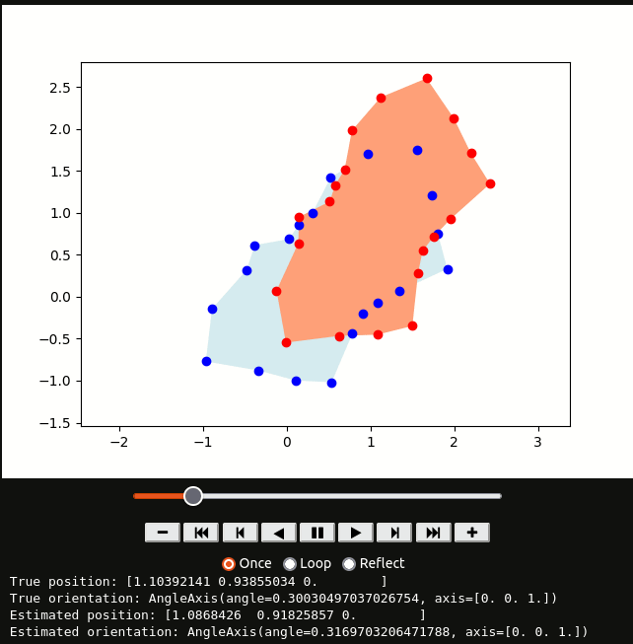
ICP
https://manipulation.mit.edu/

Slide 18
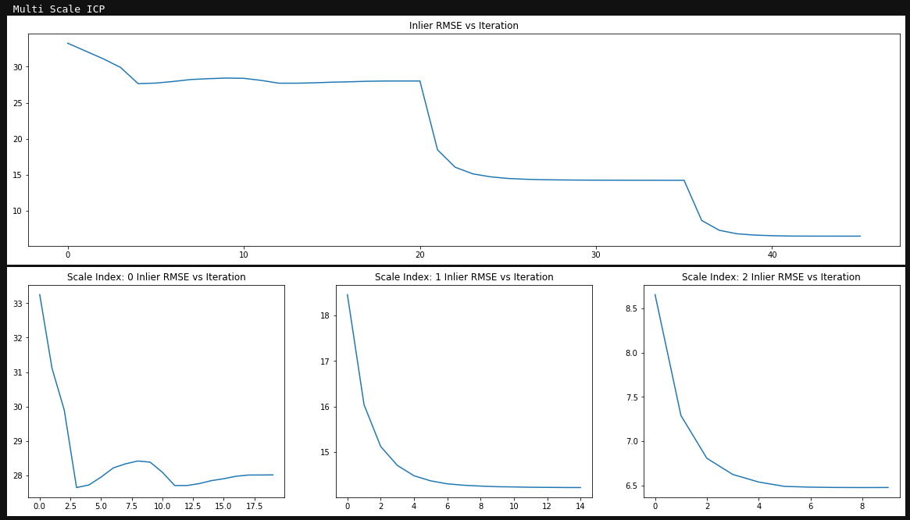
Multi-stage ICP

Slide 19
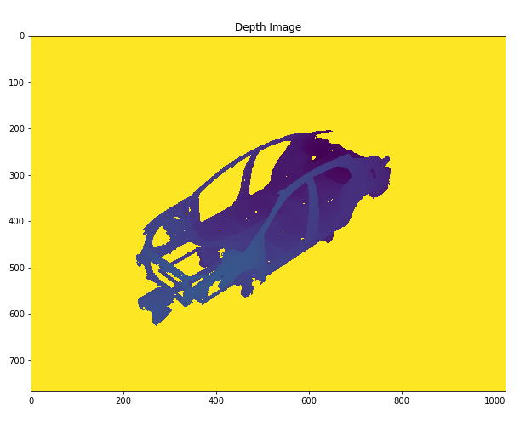
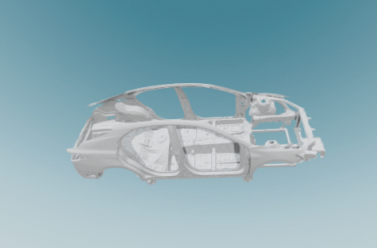
Example: STL file

Slide 20
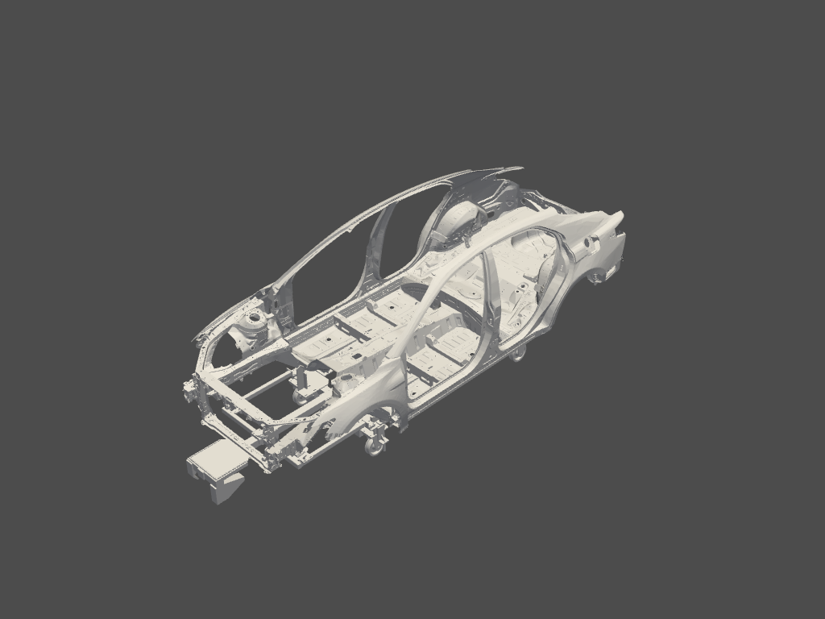
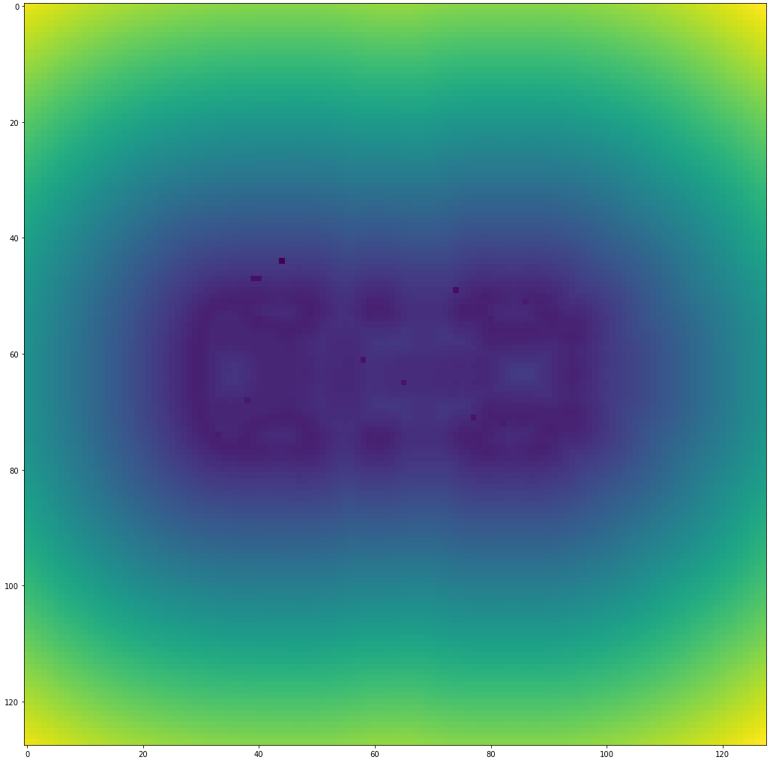
Signed Distance Field

Slide 21
Using the SDF as optimization for ICP
ICP on CPU:
random offset: [Open3D DEBUG] Read geometry::TriangleMesh: 358360 triangles and 337702 vertices.
35.7425685244515
CPU times: user 198 ms, sys: 0 ns, total: 198 ms
Wall time: 197 ms
ICP on CPU with pre-computed values:
CPU times: user 23.3 ms, sys: 0 ns, total: 23.3 ms
Wall time: 22.9 ms
T:
[[ 1.00000000e+00 6.79002783e-19 -3.70099680e-17 -3.57425685e+01]
[ 7.92129700e-18 1.00000000e+00 2.26711873e-16 -3.57425685e+01]
[ 2.19541387e-17 -5.08830505e-17 1.00000000e+00 -3.57425685e+01]
[ 0.00000000e+00 0.00000000e+00 0.00000000e+00 1.00000000e+00]]

Slide 22
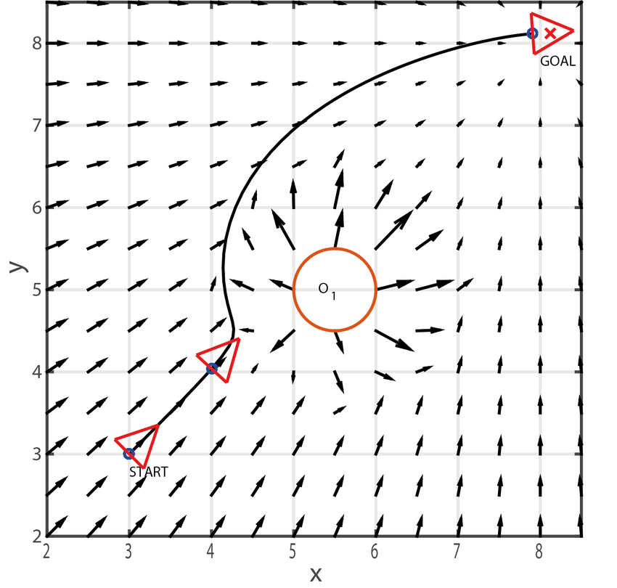
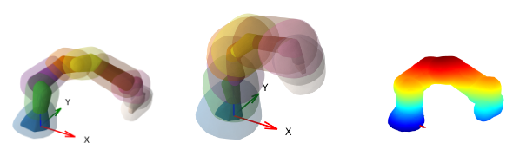
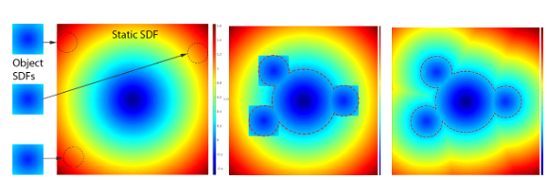
Application: trajectory planning
Real time reconstruction and motion planning in dynamic environments.

Slide 23

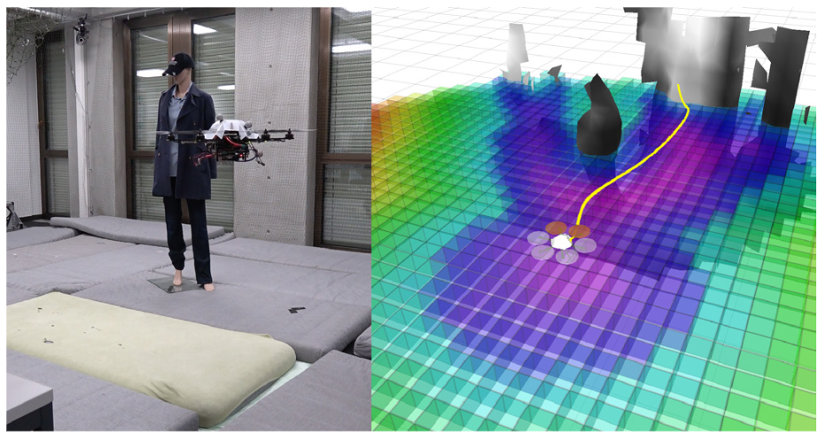
Application: VoxBlox

Slide 24
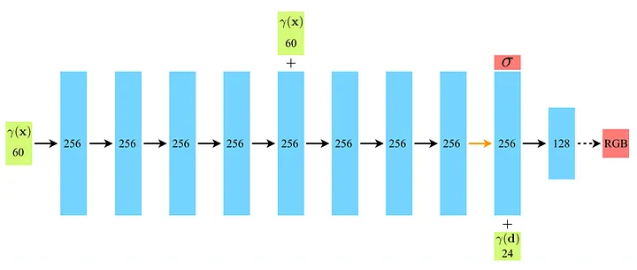
Neural Radiance Fields (NeRF)
Positional encoding:

Slide 25
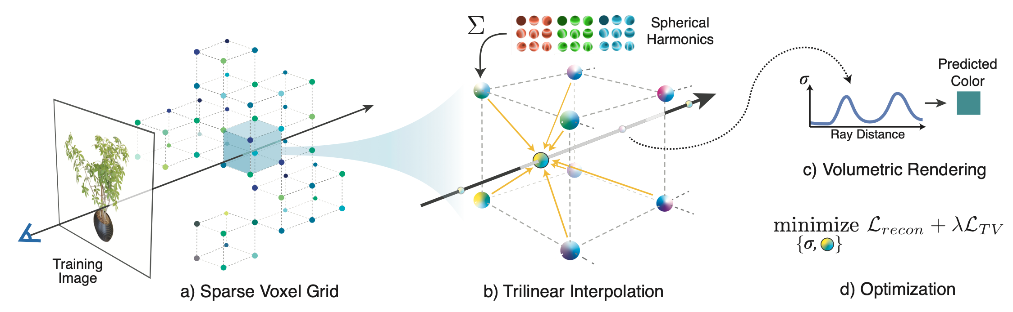
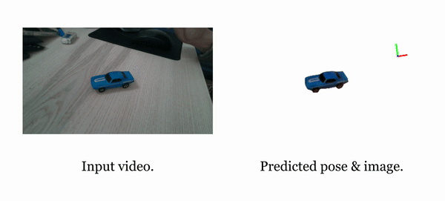
Plenoxels, iNeRF, etc...

